Slide 1
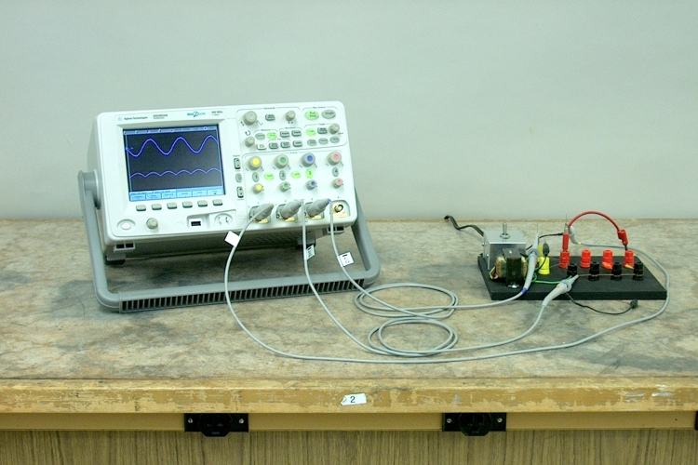
FULL WAVE RECTIFIER
Dr.A.ANBARASI
ASSOCIATE PROFESSOR
DEPARTMENT OF PHYSICS
CUDDALORE

Slide 2
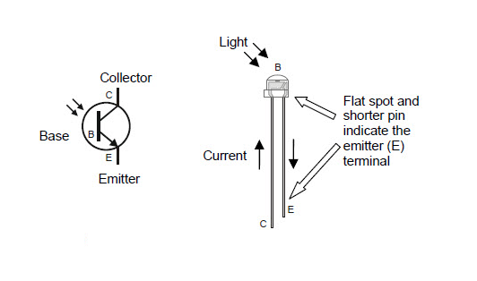

Slide 3
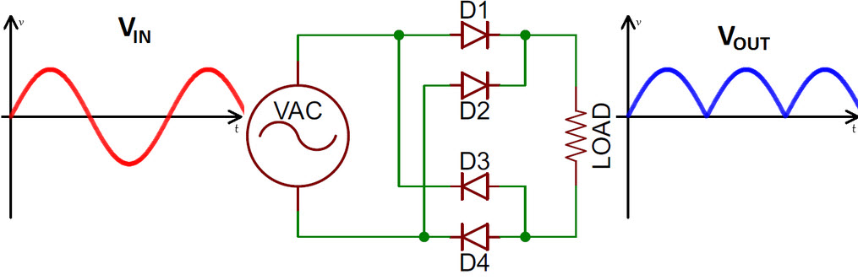
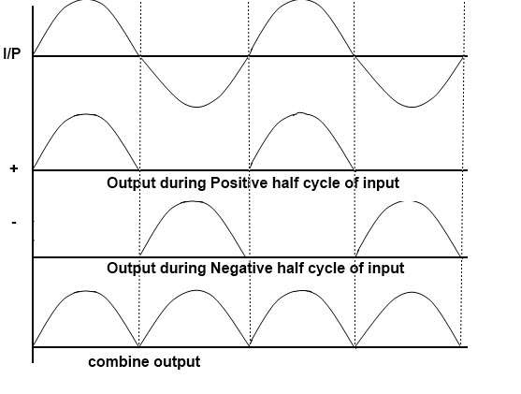
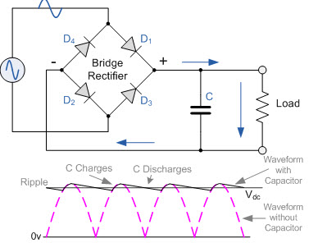
Full wave rectifier

Slide 4
Full wave rectifier
The full wave rectifier circuit consists of two power diodes connected to a single load resistance (RL) with each diode taking it in turn to supply current to the load resistor. When point A of the transformer is positive with respect to point A, diode D1 conducts in the forward direction as indicated by the arrows.When point B is positive in the negative half of the cycle with respect to C point, the diode D2 conducts in the forward direction and the current flowing through resistor R is in the same direction for both half-cycles of the wave.

Slide 5
Working of full wave rectifier
The four diodes labelled D1 to D4 are arranged in series pairs with only two diodes conducting current during each half cycle duration. When the positive half cycle of the supply goes, D1, D2 diodes conduct in a series while diodes D3 and D4 are reverse biased and the current flows through the load. During the negative half cycle, D3 and D4 diodes conduct in a series and diodes D1 and D2 switch off as they are now reverse biased configuration.

Slide 6
Working of full wave rectifier
Given Circuit gives a overview on working of full wave rectifier. A circuit that produces the same output waveform as the full wave rectifier circuit a is that of the Full Wave Bridge Rectifier. Single phase rectifier uses four individual rectifying diodes connected in a closed loop bridge configuration to produce the desired output wave. The advantage of this bridge circuit is that it does not require a special center tapped transformer, so it reduces its size and cost. Single secondary winding is connected to one side of the diode bridge network and the load to the other side.

Slide 7
RIPPLE FACTOR
the rectifier output mainly includes the AC component as well as the DC component. The ripple can be defined as the AC component within the resolved output. The A.C component within the output is unwanted as well as estimates the pulsations within the output of the rectifier. Here the ripple voltage is nothing but the AC component within o/p of the rectifier. Similarly, the ripple current is an AC component within o/p current.

Slide 8
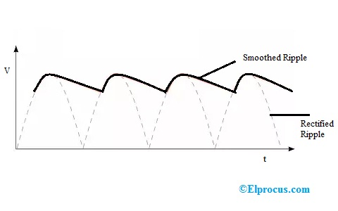
The RMS value and the DC component and RMS value within the output of the rectifier.
The symbol is denoted with gamma

Slide 9
Ripple factor derivation
Derivation
According to the definition of R.F, the whole load current RMS value can be given by
I_{RMS} = √I²_{dc} + I²_{ac}
(or)
I_{ac} = √I²_{rms} + I²_{dc}
When the above equation is divided by using Idc then we can get the following equation.

Slide 10
FULL WAVE RECTIFIER
Peak Inverse Voltage (PIV) of Centre Tap Full Wave Rectifier:
PIV is defined as the maximum possible voltage across a diode during its reverse bias. During the first half that is positive half of the input, the diode D1 is forward bias and thus conducts providing no resistance at all. Thus, the total voltage Vs appears in the upper-half of the ac supply, provided to the load resistance R. Similarly, in the case of diode D2 for the lower half of the transformer total secondary voltage developed appears at the load. The amount of voltage that drops across the two diodes in reverse bias is given as
PIV of D2 = Vm + Vm = 2Vm
PIV of D1 = 2Vm
Vm is the voltage developed across upper and lower halves.

Slide 11
Peak current
The peak current is the instantaneous value of the voltage applied to the rectifier. It can be written as
Vs = Vsm Sinwt
Let us assume that the diode has a forward resistance of RF ohms and a reverse resistance is equal to infinity, thus current flowing through the load resistance RL is given as
Im = Vsm / (R_{F} + RL)

Slide 12
Output current
Since the current is same through the load resistance RL in the two halves of the ac cycle, magnitude of dc current Idc, which is equal to the average value of ac current, can be obtained by integrating the current i1 between 0 and pi or current i2 between pi and 2pi.

Slide 13
FULL WAVE RECTIFIER DERIVATION

Slide 14
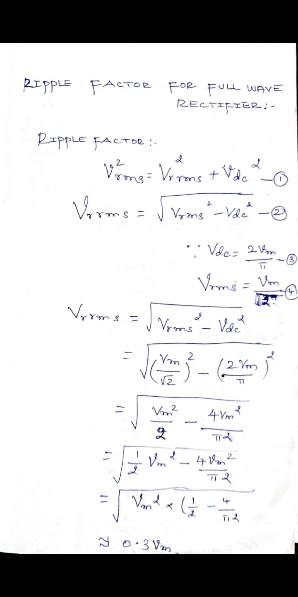

Slide 15
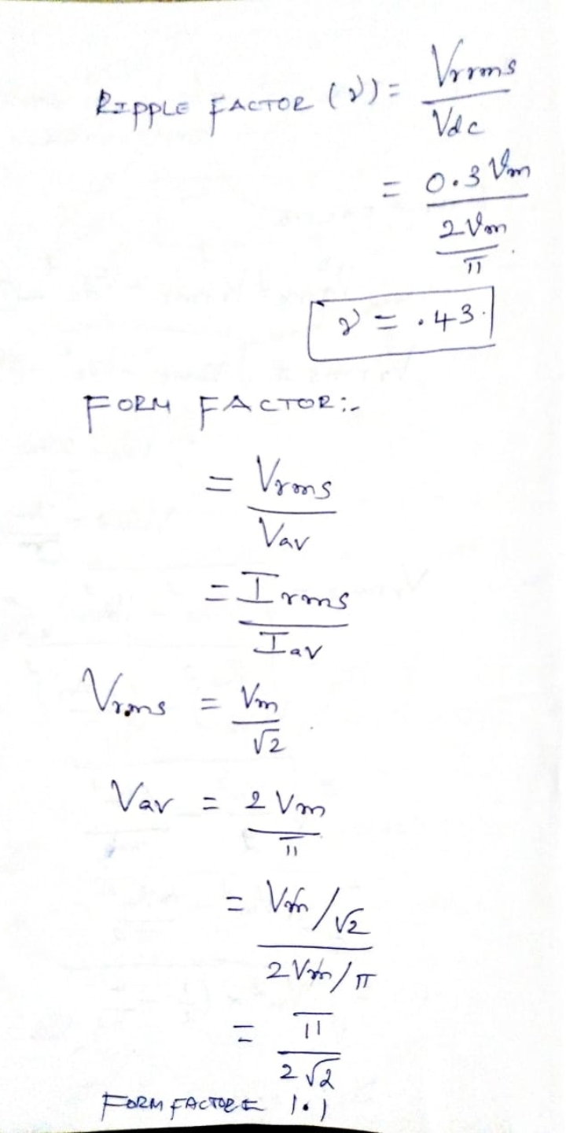

Slide 16
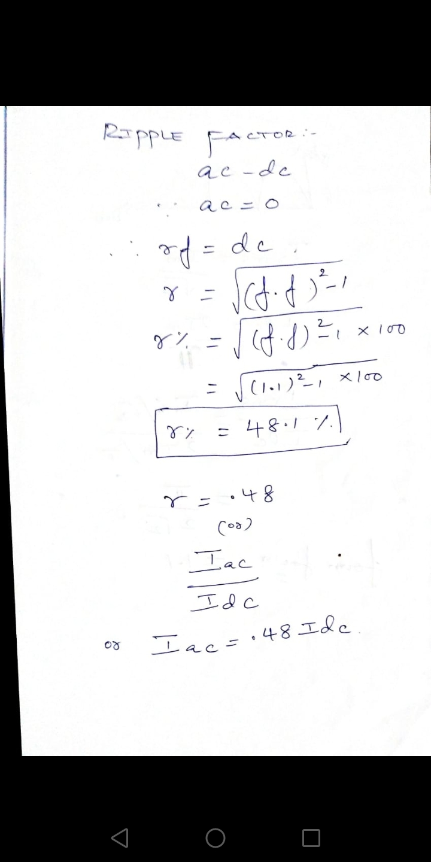

Slide 17
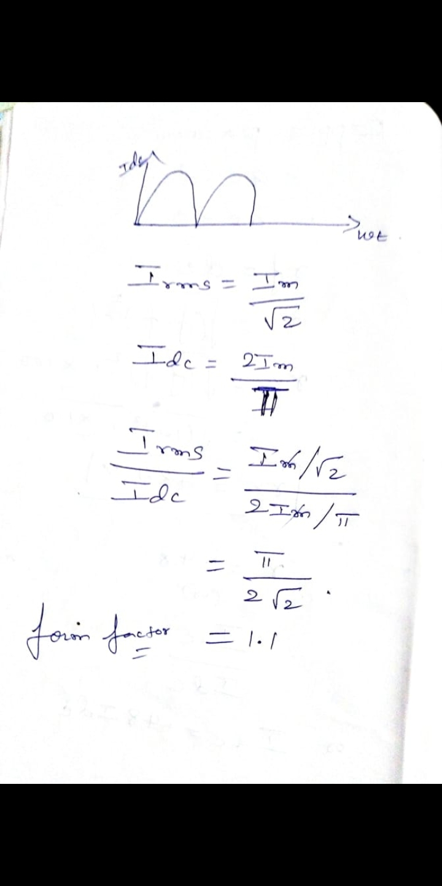

Slide 18
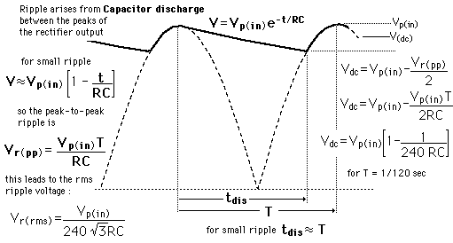

Slide 19
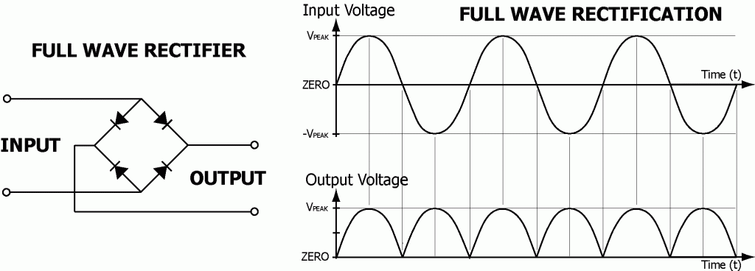

Slide 20
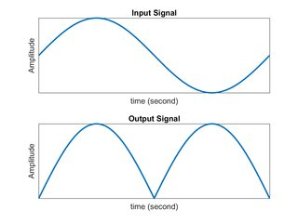

Slide 21
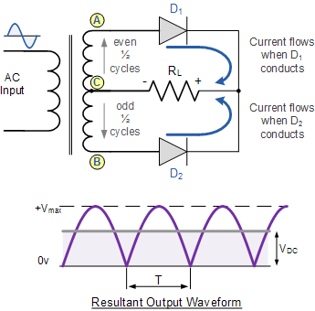
FULL WAVE RECTIFIER

Slide 22
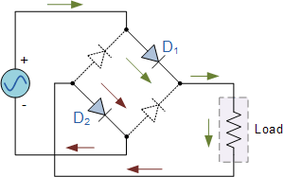
During positive half cycle

Slide 23
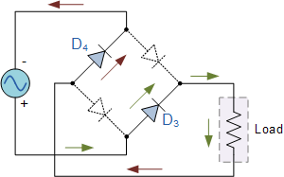
Negative half cycle

Slide 24


